Slide 1
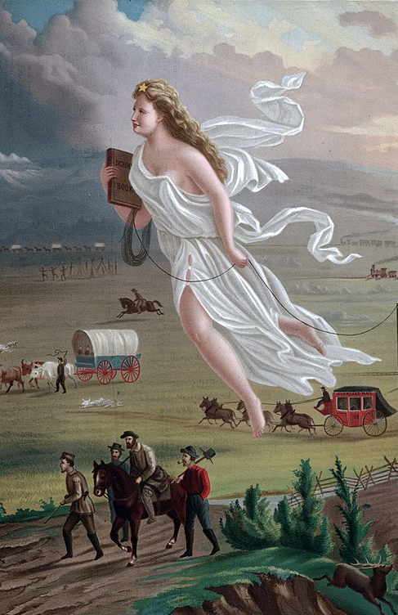
MANIFEST DESTINY: AMERICAN DIPLIMACY FROM 1820s-1850s
Presented by Zhang Wei

Slide 2
TABLE OF CONTENTS
Anglo-American frictions
1
West Indies; Canada; Maine; Oregon
2
Mexico & Texas
Texas annexation; Mexican American War
3
Manifest Destiny
Themes and cases

Slide 3
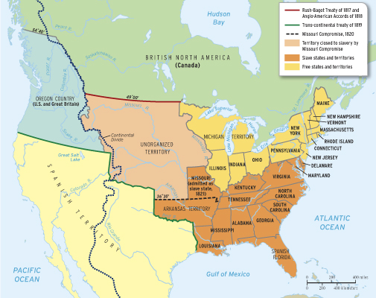
America in 1820

Slide 4
01
Anglo-American Frictions
West Indies; Canada; Maine; Oregon

Slide 5
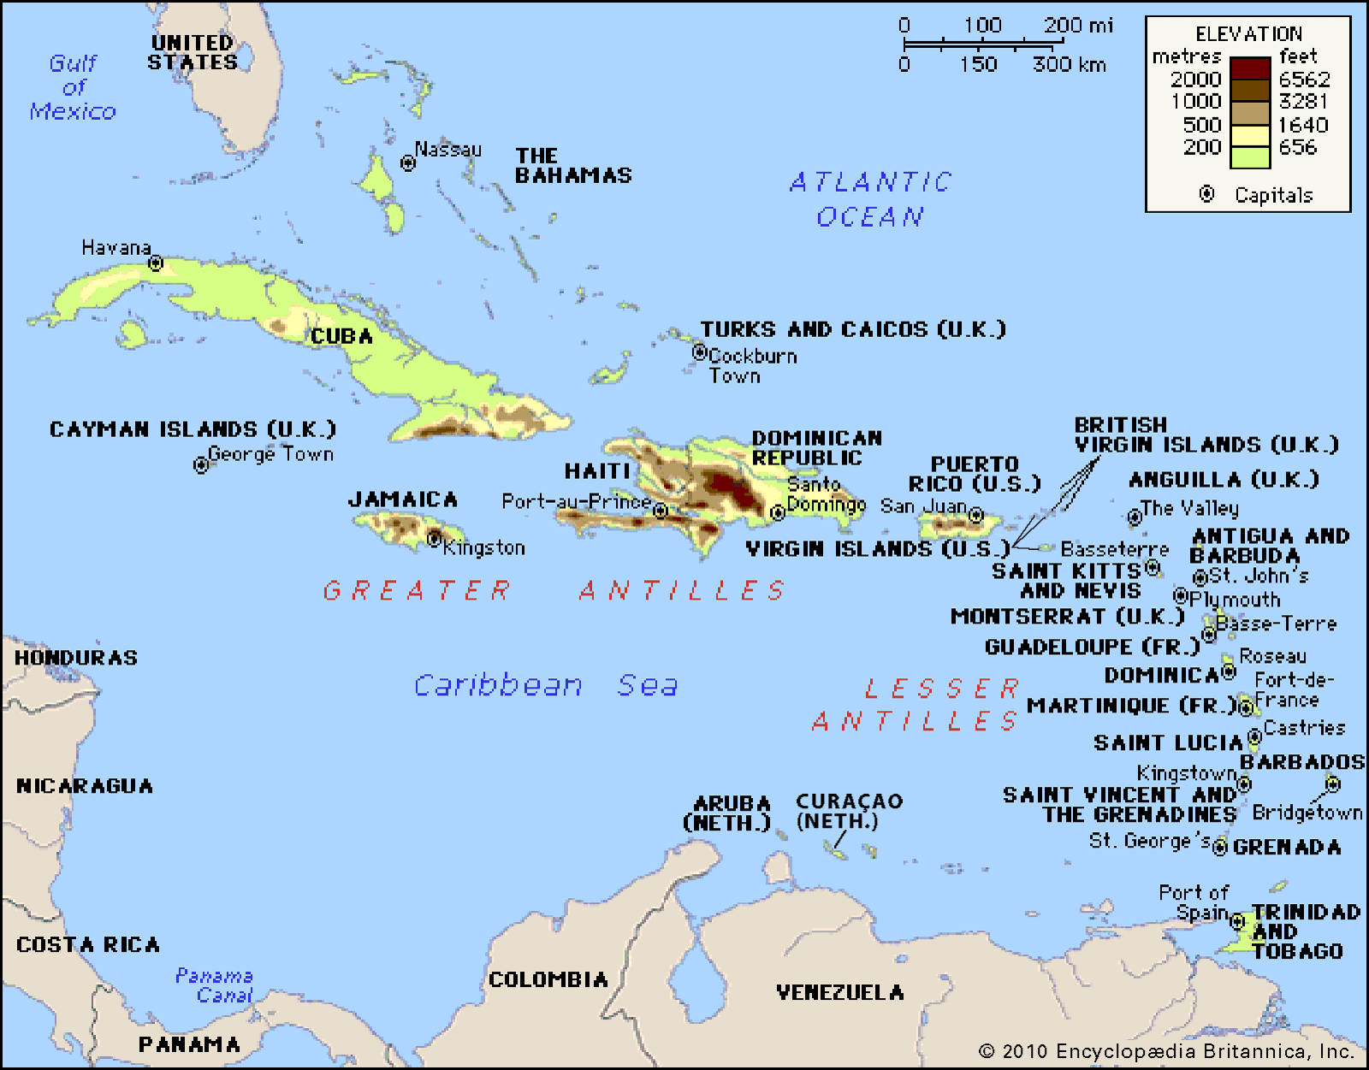
WEST INDIAN CONTROVERSY
Monroe | Adams | Jackson | Van Buren | Harrison | Tyler | Polk | Taylor | Fillmore | Pierce | Buchanan | Lincoln

Slide 6
WEST INDIAN CONTROVERSY
1
🇺🇸
🇬🇧
✕
🇺🇸 exclusion from trading with west Indies
🇺🇸 retaliatory trade legislation against the British (1817-1820)
🌳 Planters in west indies petitioned Parliament
🇬🇧 Parliament opened certain ports with strict terms (1822)
discriminatory tariff
intercolonial preferences
Monroe | Adams | Jackson | Van Buren | Harrison | Tyler | Polk | Taylor | Fillmore | Pierce | Buchanan | Lincoln

Slide 7
WEST INDIAN CONTROVERSY
1
🇺🇸
🇬🇧
✕
🇺🇸 John Quincy Adams became president (1825)
🇬🇧 gave the US certain concessions
🇺🇸 Adams was too bold to compromise
🇬🇧 Britain excluded all American ships from the West Indies until the US should repeal its discriminatory duties. (1826)
Monroe | Adams | Jackson | Van Buren | Harrison | Tyler | Polk | Taylor | Fillmore | Pierce | Buchanan | Lincoln

Slide 8
WEST INDIAN CONTROVERSY
1
🇺🇸
🇬🇧
✕
🇺🇸 Adams sent Albert Gallatin to London to negotiate an agreement, asked the congress for support, eventually issued a proclamation, banning British ships from entering America (1827)
👹Adams’s Political enemies: “he will find it hard to resist the imputation of having trifled with a very valuable portion of commerce”
Monroe | Adams | Jackson | Van Buren | Harrison | Tyler | Polk | Taylor | Fillmore | Pierce | Buchanan | Lincoln

Slide 9
WEST INDIAN CONTROVERSY
1
🇺🇸
🇬🇧
✕
🇺🇸 change of presidency: Adams ---- Jackson
🇬🇧 change of ministry: Canning ---- Aberdeen
Reciprocity of 1830
🇺🇸 the discriminatory duties repealed and American ports opened
🇬🇧 opened its west indies to direct trade with the US
Monroe | Adams | Jackson | Van Buren | Harrison | Tyler | Polk | Taylor | Fillmore | Pierce | Buchanan | Lincoln

Slide 10
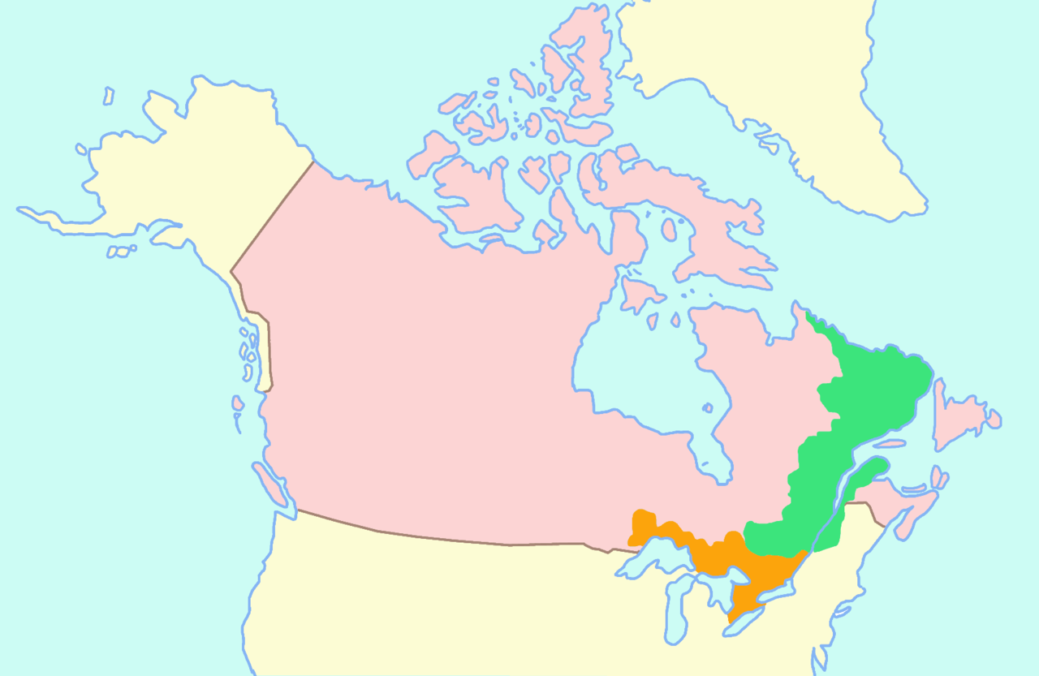
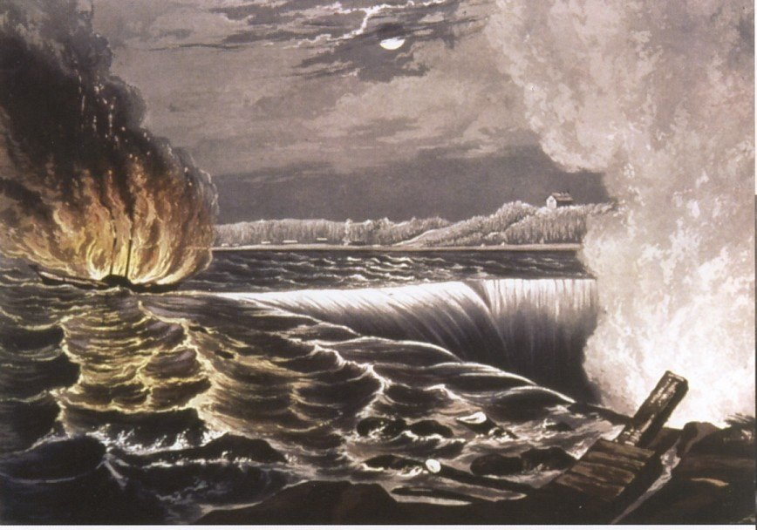
The Caroline Incident
Monroe | Adams | Jackson | Van Buren | Harrison | Tyler | Polk | Taylor | Fillmore | Pierce | Buchanan | Lincoln

Slide 11
The Caroline Incident
2
🇺🇸
🇬🇧
✕
Two rebellions against the British Crown in 1837
🇺🇸 American people sympathized with the Canadian people
🇺🇸 American Government remained neutral
“Patriots” & “Caroline”
The Caroline steamship was destroyed by Canadian authorities on the land of New York
Even more anti-British sentiment in America
Monroe | Adams | Jackson | Van Buren | Harrison | Tyler | Polk | Taylor | Fillmore | Pierce | Buchanan | Lincoln

Slide 12
The Caroline Incident
2
🇺🇸
🇬🇧
✕
Secret Societies
Canadian Refugee Relief Association (“remember the Caroline”)
The Hunters and Chasers of the Eastern Frontier (“never to rest until all tyrants of Britain cease to have any dominion or footing whatever in North America”)
Alexander Mcleod
🇺🇸 America charged him of murder during the Caroline raid
🇬🇧 The British government insisted his release.
change of state secretary & ministry; Treaty of 1842
Monroe | Adams | Jackson | Van Buren | Harrison | Tyler | Polk | Taylor | Fillmore | Pierce | Buchanan | Lincoln

Slide 13
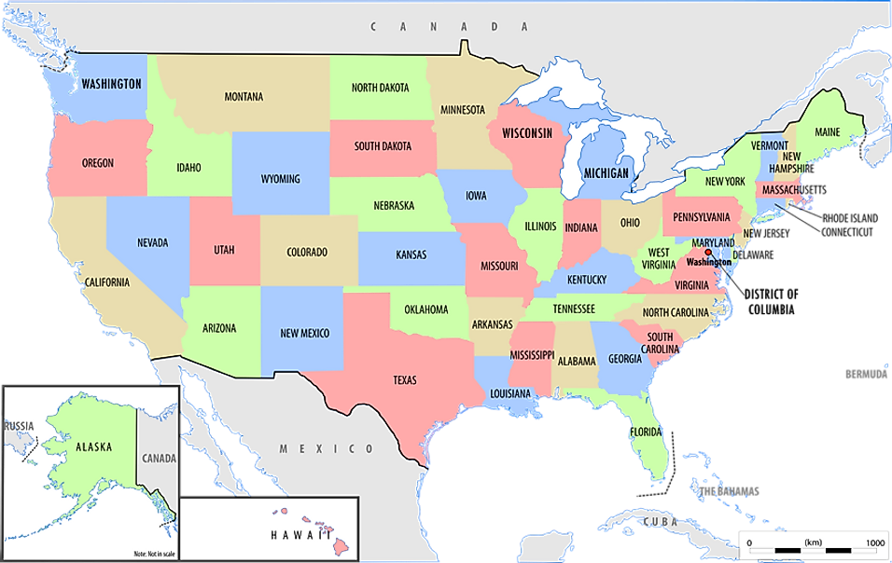
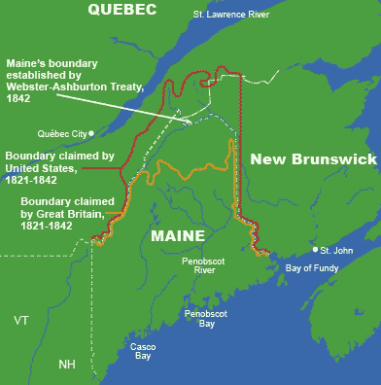
The Maine Boundary Dispute
Monroe | Adams | Jackson | Van Buren | Harrison | Tyler | Polk | Taylor | Fillmore | Pierce | Buchanan | Lincoln

Slide 14
The Maine Boundary Dispute
3
🇺🇸
🇬🇧
✕
Population increased
Lumberjacks conflicts
Aroostook “War”, 1838-1839
Resolved through the Treaty of 1842
Monroe | Adams | Jackson | Van Buren | Harrison | Tyler | Polk | Taylor | Fillmore | Pierce | Buchanan | Lincoln

Slide 15
The Webster-Ashburton Treaty in 1842
🇺🇸
🇬🇧
✕
Daniel Webster 🇺🇸
A Whig State Secretary, neither martial nor anti-British
Carried out campaign of propaganda, persuasion, and coercion to settle the disagreement
Lord Ashburton 🇬🇧
Appointed by by lord Aberdeen, friendlier towards the US
His wife was American; he had social and business connection in America
Monroe | Adams | Jackson | Van Buren | Harrison | Tyler | Polk | Taylor | Fillmore | Pierce | Buchanan | Lincoln

Slide 16
The Webster-Ashburton Treaty in 1842
🇺🇸
🇬🇧
✕
Maine issue
🇬🇧 Britain’s claim: assure the proposed military road to Britain
🇺🇸 America’s claim: dispute between Maine and Massachusetts
Caroline issue
Only mentioned in their notes
No binding effects
Monroe | Adams | Jackson | Van Buren | Harrison | Tyler | Polk | Taylor | Fillmore | Pierce | Buchanan | Lincoln

Slide 17
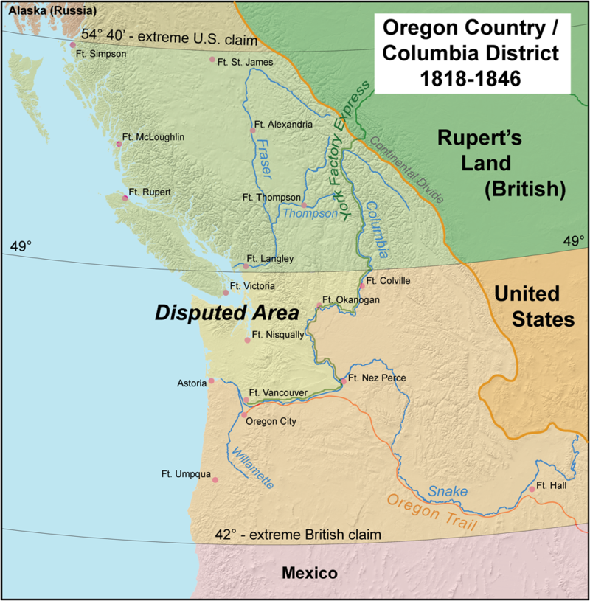
The Oregon Question
Monroe | Adams | Jackson | Van Buren | Harrison | Tyler | Polk | Taylor | Fillmore | Pierce | Buchanan | Lincoln

Slide 18
The Oregon Question--Conflicting Claims
🇺🇸 America’s claim:
captain Robert Gray’s discovery of the Columbia River in 1792
the official expedition of Lewis and Clark in 1805
John Jacob Astor’s Pacific Fur Company post
Louisiana Purchase; the Oregon country was a natural extension of Louisiana
🇬🇧 Britain’s claim:
Sir Francis Drake’s voyage in 1579
Captain James Cook’s in 1778
Captain George Vancouver’s in 1792…
4
🇺🇸
🇬🇧
✕
Unresolved, leaving the region open to the people for ten years
Monroe | Adams | Jackson | Van Buren | Harrison | Tyler | Polk | Taylor | Fillmore | Pierce | Buchanan | Lincoln

Slide 19
The Oregon Question—American migration
influence of the early Oregon promoters, writers and travelers
the rich agricultural possibilities of the land, esp., the Willamette Valley
fleeing years of depression following the Panic of 1837
“the whole of Oregon”
1844 presidential election
Monroe | Adams | Jackson | Van Buren | Harrison | Tyler | Polk | Taylor | Fillmore | Pierce | Buchanan | Lincoln

Slide 20
The Oregon Question—Polk’s policy
To press for as much of Oregon beyond the Columbia River as he could get.
John L. O’Sullivan, “manifest destiny” (1845)
Congressmen, “under the law of nature and nations”
For Western expansionist Democrats, this was a no brainier
For Whigs, they wanted the trade of Asia, so they need ports on the pacific
Fear of war + quest for California + many other factors made them accept a compromise, which finally led to the Oregon Treaty in 1846
Monroe | Adams | Jackson | Van Buren | Harrison | Tyler | Polk | Taylor | Fillmore | Pierce | Buchanan | Lincoln

Slide 21
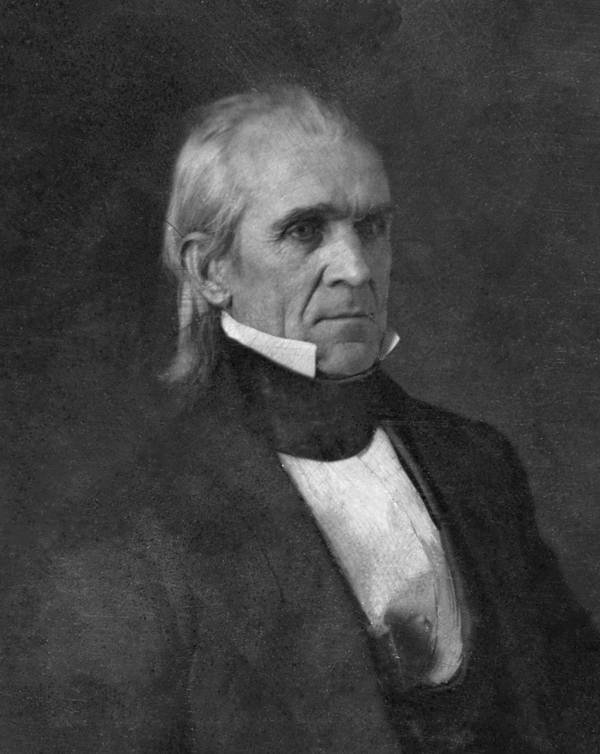
—James K. Polk
Our title to the country of the Oregon is clear and unquestionable, and already are our people preparing to perfect that title by occupying it with their wives and children .

Slide 22
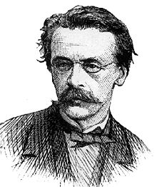
—John L. O’Sullivan
The true title to Oregon lay in “our manifest destiny to overspread and to possess the whole of the continent which Providence has given us.”

Slide 23
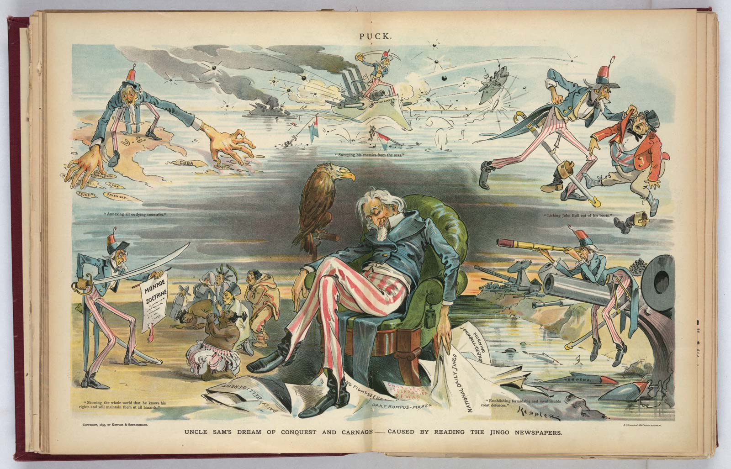

Slide 24
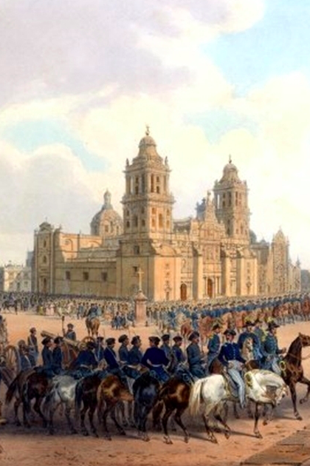
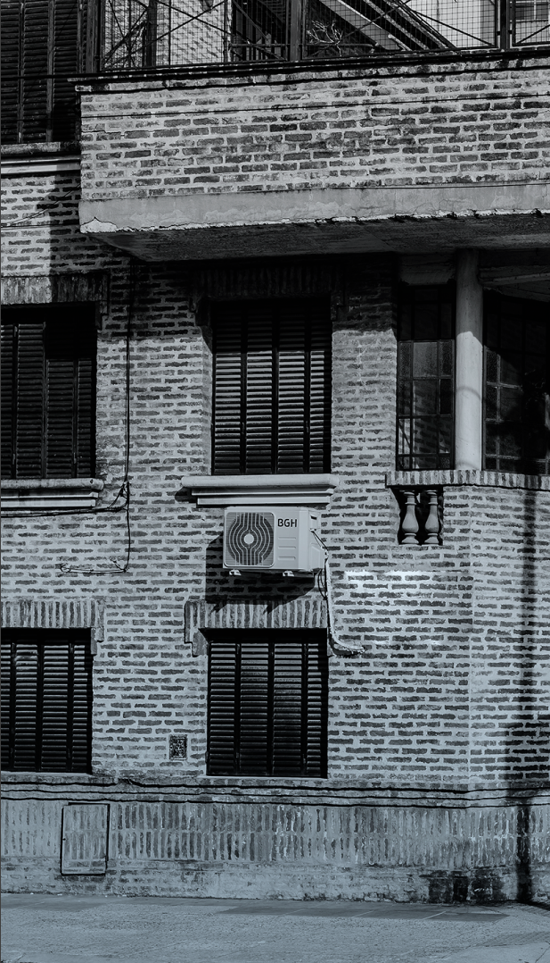
Quiz
Which of the following issues is among the Anglo-American frictions?
Louisiana Purchase
Maine Boundary Dispute
Annexation of Texas
Mexican-American War

Slide 25
02
Mexico & Texas

Slide 26
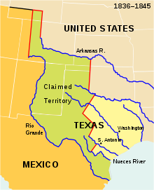
Mexico & Texas
Monroe | Adams | Jackson | Van Buren | Harrison | Tyler | Polk | Taylor | Fillmore | Pierce | Buchanan | Lincoln

Slide 27
Texas annexation
Texas declared independence in 1836 and applied for annexation to the US.
US rejected it, as
Political leaders rejected to include Texas to risk breaking the pro- and anti-slavery political balance.
To avoid war with Mexico
John Tyler, expansionist
pursued the annexation of Texas; Tyler
tried very hard to secure a treaty of annexation in 1844 before leaving the white house
James Polk encouraged Texas to accept Tyler’s treaty
Texas formally joined America in 1846
Monroe | Adams | Jackson | Van Buren | Harrison | Tyler | Polk | Taylor | Fillmore | Pierce | Buchanan | Lincoln

Slide 28
Mexican American War
From 1846 - 1848
🇺🇸 The American side: boundary = Rio Grande River
🇲🇽 The Mexican side: boundary = Nueces River
War started
Treaty of Guadalupe Hidalgo ended the war, with Mexico accepting the Rio Grande as its northern border with the US
Monroe | Adams | Jackson | Van Buren | Harrison | Tyler | Polk | Taylor | Fillmore | Pierce | Buchanan | Lincoln

Slide 29
03
Manifest Destiny

Slide 30
Manifest Destiny
key themes:
the special virtues of the American people and their institutions
their mission to redeem and remake the world in the image of America
the American destiny under God to accomplish this sublime task
Before the Civil War, the idea of Manifest Destiny was used to validate continental acquisitions in the Oregon Country, Texas, New Mexico, and California.
After the Civil War, it was used to justify the purchase of Alaska and annexation of Hawaii.
Manifest destiny had serious consequences for Native Americans.
Monroe | Adams | Jackson | Van Buren | Harrison | Tyler | Polk | Taylor | Fillmore | Pierce | Buchanan | Lincoln

Slide 31
New Manifest Destiny
influenced by social Darwinism, “survival of the fittest”
clothing imperial ambitions in a higher purpose ostensibly decreed by Providence
the dogma of Anglo-Saxon superiority, Anglo-American rapprochement
Monroe | Adams | Jackson | Van Buren | Harrison | Tyler | Polk | Taylor | Fillmore | Pierce | Buchanan | Lincoln

Slide 32
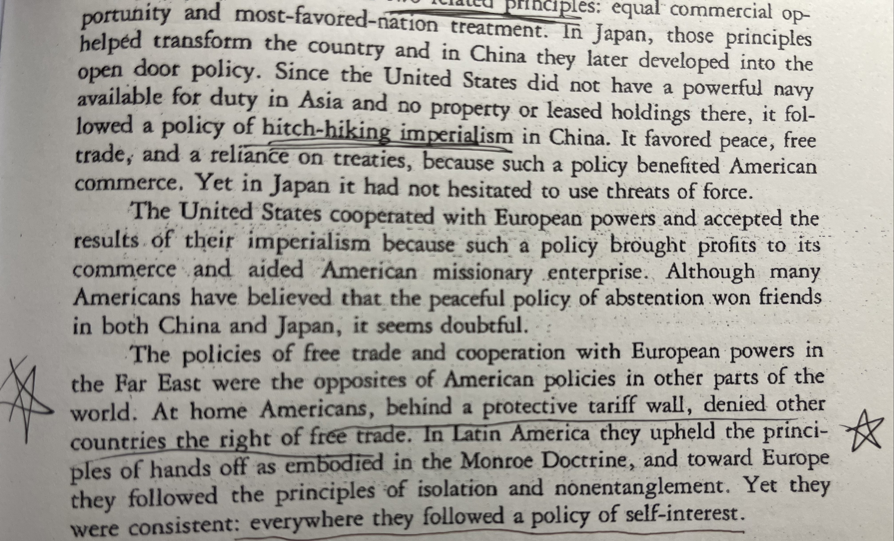
Conclusion
American Policy
Far East: free trade
Home: a protective tariff
Latin America: Monroe Doctrine
Europe: non-entanglement

Slide 33

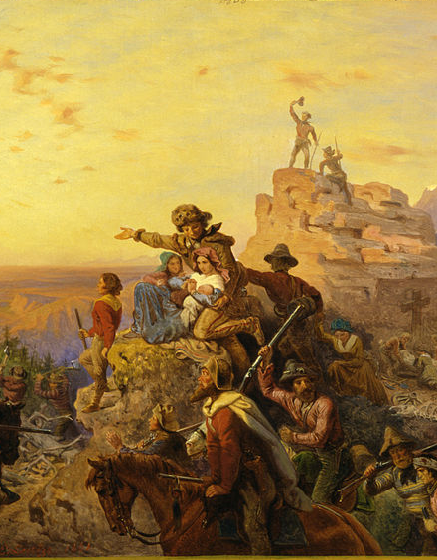
THANKS!
Do you have any questions?

Slide 34
RESOURCES
DeConde, A History of American Foreign Policy, pp.134-162, pp.190-221, pp.288-308 and pp.325-355.
Paintings
John Gast’s American Progress (1872)
Emanuel Leutze’s Westward the Course of Empire Takes Its Way (1861)
Udo J. Keppler’s Uncle Sam dreaming of conquest (1895)
American Occupation of the Mexico City
Maps
World Atlas
Wikipedia

